Slide 1


EXPLORATORY DATA ANALYISIS
Presented by Hazem Elsheikh

Slide 2
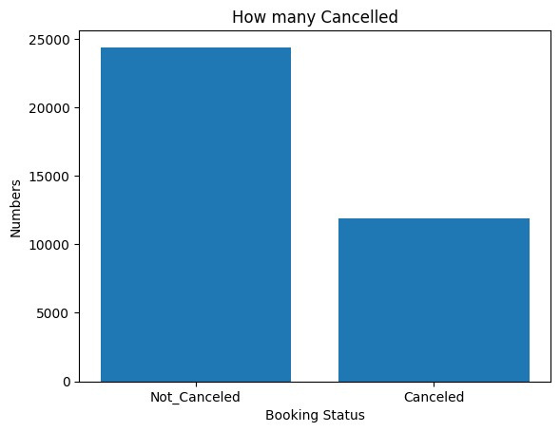

NO. CANCELLED RESERVATIONS
Number of Canceled Reservations are very high despite having a lot of reservation requests.
Around 33% of reservation were canceled
Count of Total Cancelations and Confirmations

Slide 3

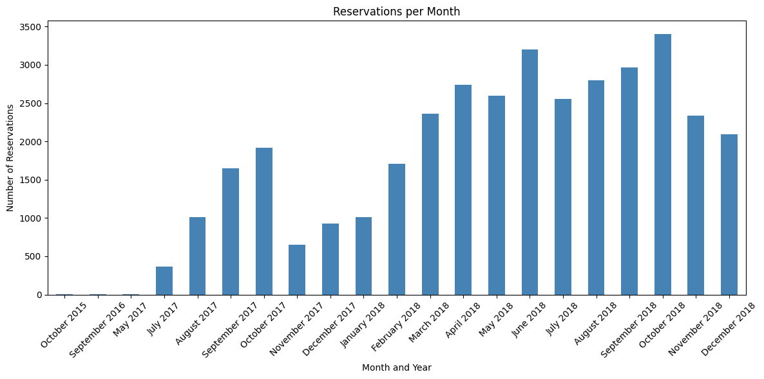
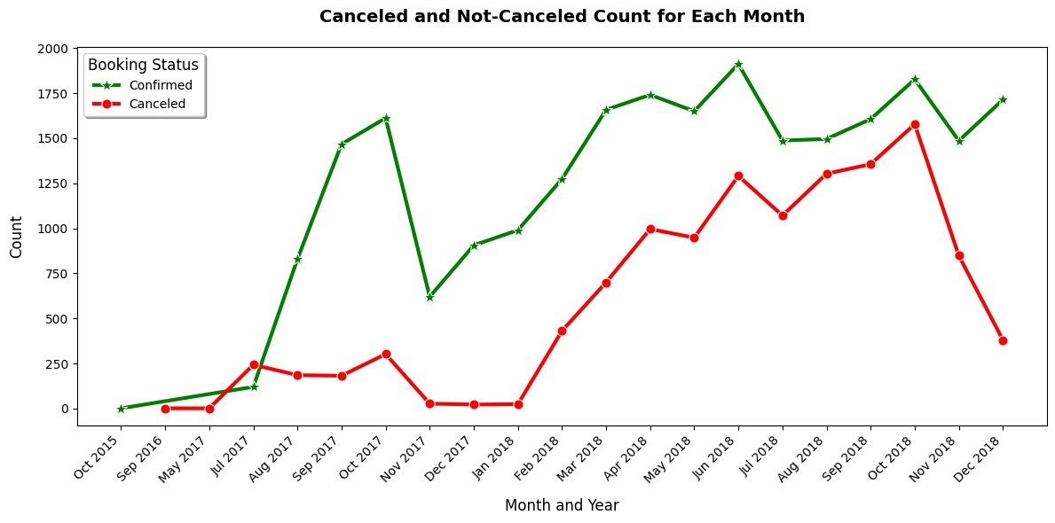
RESERVATION DATES
Number of Requested Reservations Per Month
Number of Canceled/Not-Cancelled Reservations Per Month

Slide 4
RESERVATION DATES INSIGHTS
Between October 2015 and July 2017, the hotel experienced low reservation levels.
This period saw similar cancellation and confirmation rates due to limited demand.
Post-July 2017, the hotel's popularity surged.
Cancellation rates noticeably declined while confirmed reservations increased.
This change reflected improved customer interest and satisfaction.
From January 2018 to October 2018, cancellations unexpectedly increased despite continued popularity.
The rise in cancellations was likely due to internal issues rather than external factors or seasonal trends.
From October 2018 onwards, cancellation rates reduced.
This reduction implied that underlying problems had been addressed.
Customer confidence was restored, stabilizing reservations.
Number of Canceled/Not-Cancelled Reservations Per Month

Slide 5

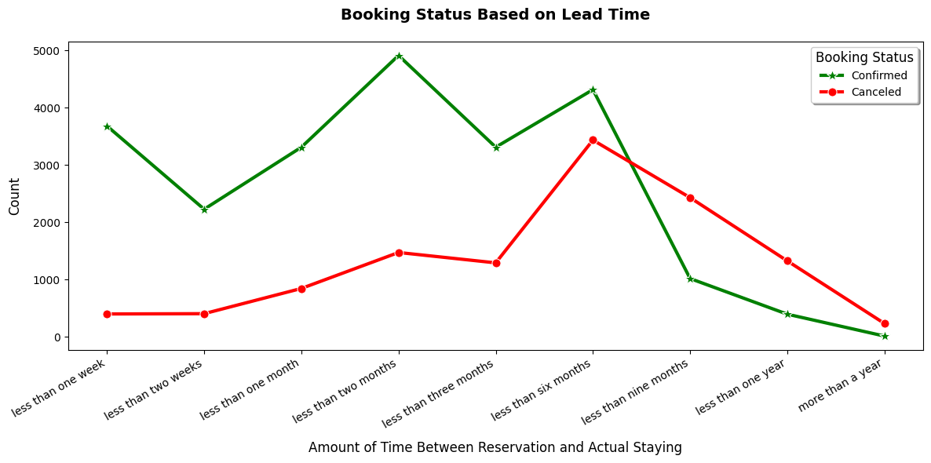
CANCELATION BASED ON LEAD TIME
Number of Canceled/Not-Cancelled Reservations Based on Lead Time

Slide 6
LEAD TIME INSIGHTS
Lead Time is the time between the date of reservation and the date of actual staying in the hotel
The more the lead time is, the more probability of cancelation
Cancelations are very high for the costumers with lead time between three and six months
For lead times more than six month, the cancellations are higher than the confirmed ones even if the reservation requests are low
Number of Canceled/Not-Cancelled Reservations Based on Lead Time

Slide 7
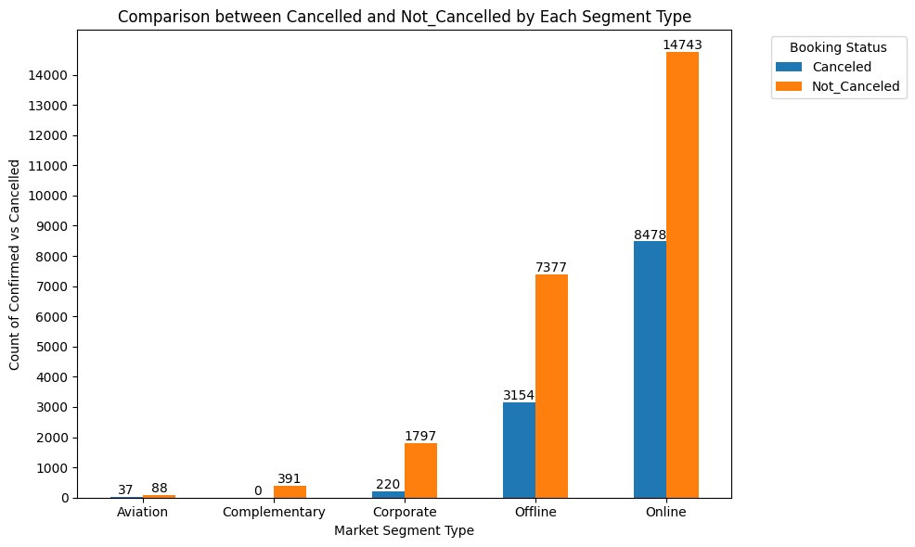
CANCELATION FOR EACH MARKET SEGMENT
Number of Canceled/Not-Cancelled Reservations for Each Market Segment Type

Slide 8
MARKET SEGMENT TYPE INSIGHTS
Most of both the reservations and cancelations were made online
Cancelations from offline is also high
Cancelation percentage for both offline and online booking is around 50%
Cancelations made by corporates are very low
Complementary reservations are all confirmed
Number of Canceled/Not-Cancelled Reservations Based on Lead Time

Slide 9
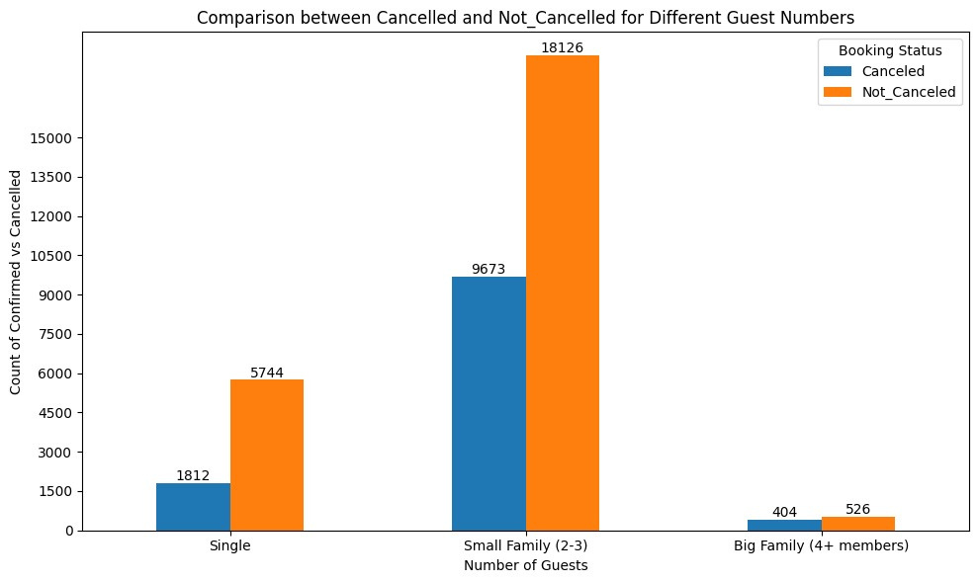
NUMBER OF GUESTS INSIGHTS
Most reservations were made by small families or groups consisting of two or three people.
Reservations for singles followed closely behind in frequency.
Larger groups have a high cancellation percentage, despite having a low total number of reservations.
The likelihood of cancellation increases with the number of people in the reservation.
Number of Cancelations based on number of guests

Slide 10
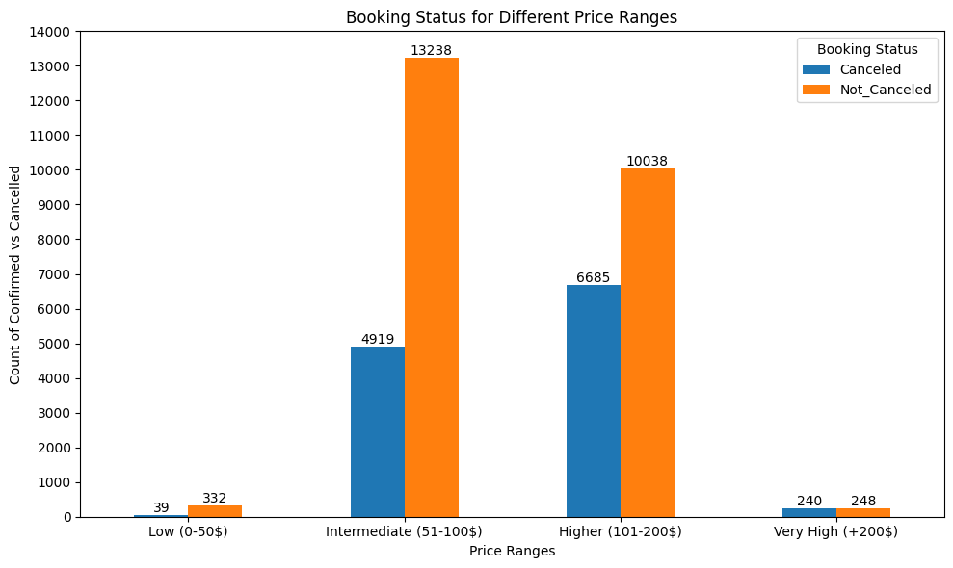
PRICE RANGES INSIGHTS
Most of reservations were made with intermediate and high average average price
The higher the price, the more likelihood of cancelation
Number of Cancelations based on average price

Slide 11
THANK YOU

